Slide 1



Star & Save
Initial Pulse Check
Kelly Peterson
Date: April 14 2023

Slide 2



Research Approach
RESEARCH PARTICIPANTS
We allowed for natural fallout of the sample which led to the following breakdowns in DoorDash experience:
On April 13th we completed 6, 15 min Cx interviews. All Cx recruited were…
Located in a Star and Save test market
In the Star and Save treatment group
Logged into the app during the time of Star and Save
Time on DoorDash | # of respondents
Less than 1 month | 1
1 month - less than one year | 0
1-3 years | 3
4+ years | 2
The goal of these calls were to…
Collect initial reactions to Star and Save
Scope awareness/recall of the offering
Identify areas of confusion or misunderstanding with the process
Understand reasons why used or did not use Star and Save
Frequency of ordering | # of respondents
Less than once a month | 1
1-2 times per month | 1
3-4 times per month | 3
Multiple times per week | 1
The research brief can be found here. This brief is a static document and will update as we continue to have weekly calls with Star and Save Cx. You can watch the interview videos here.
Notes:
James to link to failed session

Slide 3
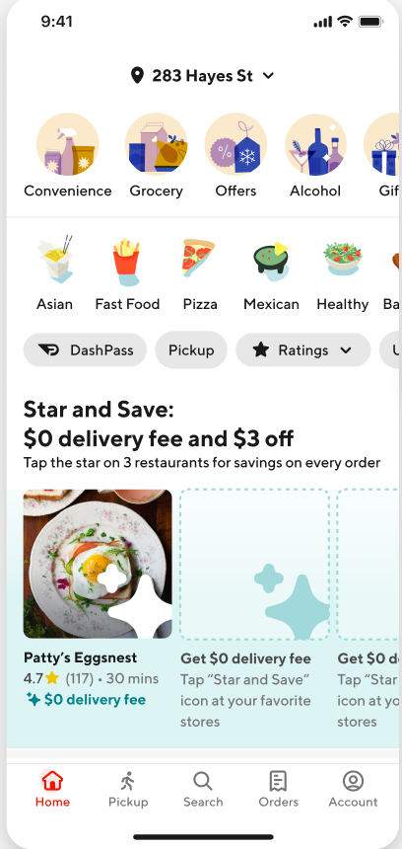
Product recall is fairly strong with at least some form of recognition among Cx
Of the 6 Cx interviewed…
2
4
2
Recalled Star and Save with limited prompting (unaided)
“ Have you noticed anything new in the app that helps you save on the cost of DoorDash?”
Recalled Star and Save after prompting with an image (aided)
Completed at least one Star & Save purchase
Note: One Cx thought she had completed a purchase but after diving deeper into her experience it appears she completed a purchase for a Happy Hour or Mx Funded $0 delivery offer

Slide 4
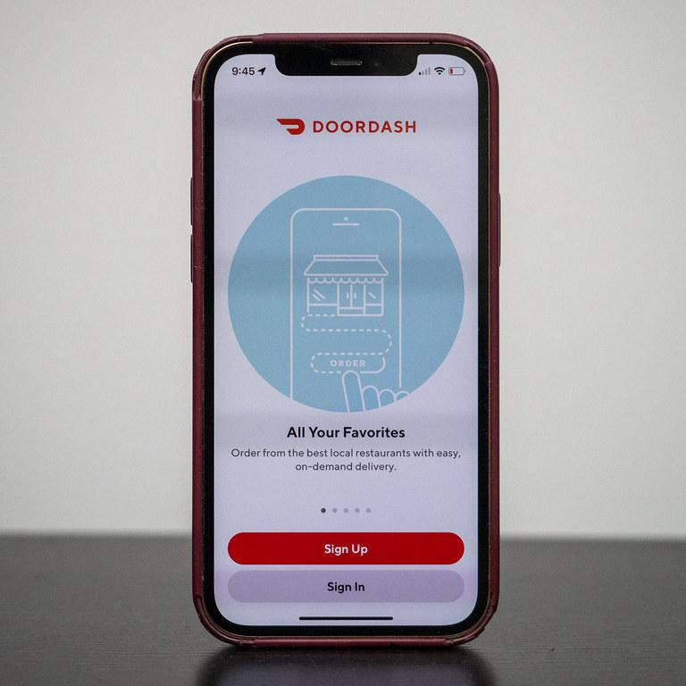
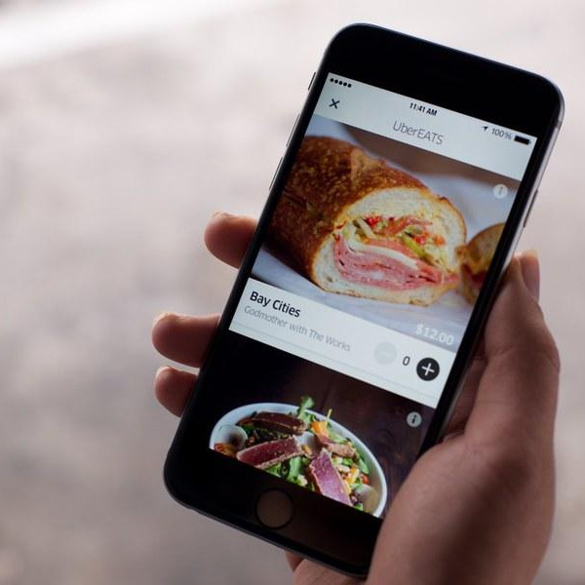
Converted Cx were intercepted while searching and took the time to learn more
Cx that converted were already established, regular DoorDash users
Cx found out about Star and Save when searching for one of their regularly used restaurant
Cx recalled seeing Star and Save on the homepage, they went back to learn how it worked.

Slide 5
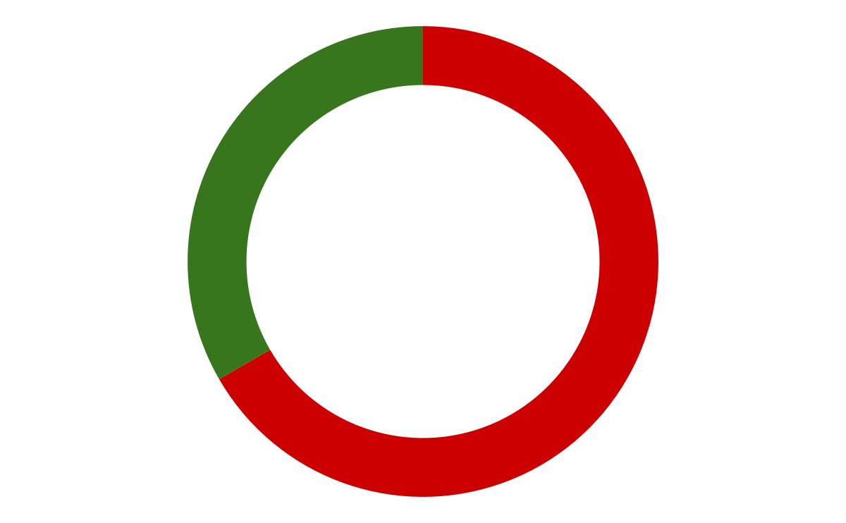
Pre-selected stores appear to play a large role in conversion
Did we have the right store in the preselected spot?
2 Cx indicated we had pre-selected a store that was one of their favorites.
These are the same Cx that converted
Both Cx were habitual users (once a week or more often)
4 Cx indicated we had not pre-selected a store that was one of their favorites.
These are the same Cx that did not convert.
Two of these Cx are new users/new account creators while the other two are occasional Cx
Most Cx indicated McDonalds was in this spot
Yes
No
Questions for further discussion:
At what point do we have enough data on a Cx to select the right Rx?
Should we pre-select if we do not have the right data threshold?
Should new Cx have a different experience?

Slide 6
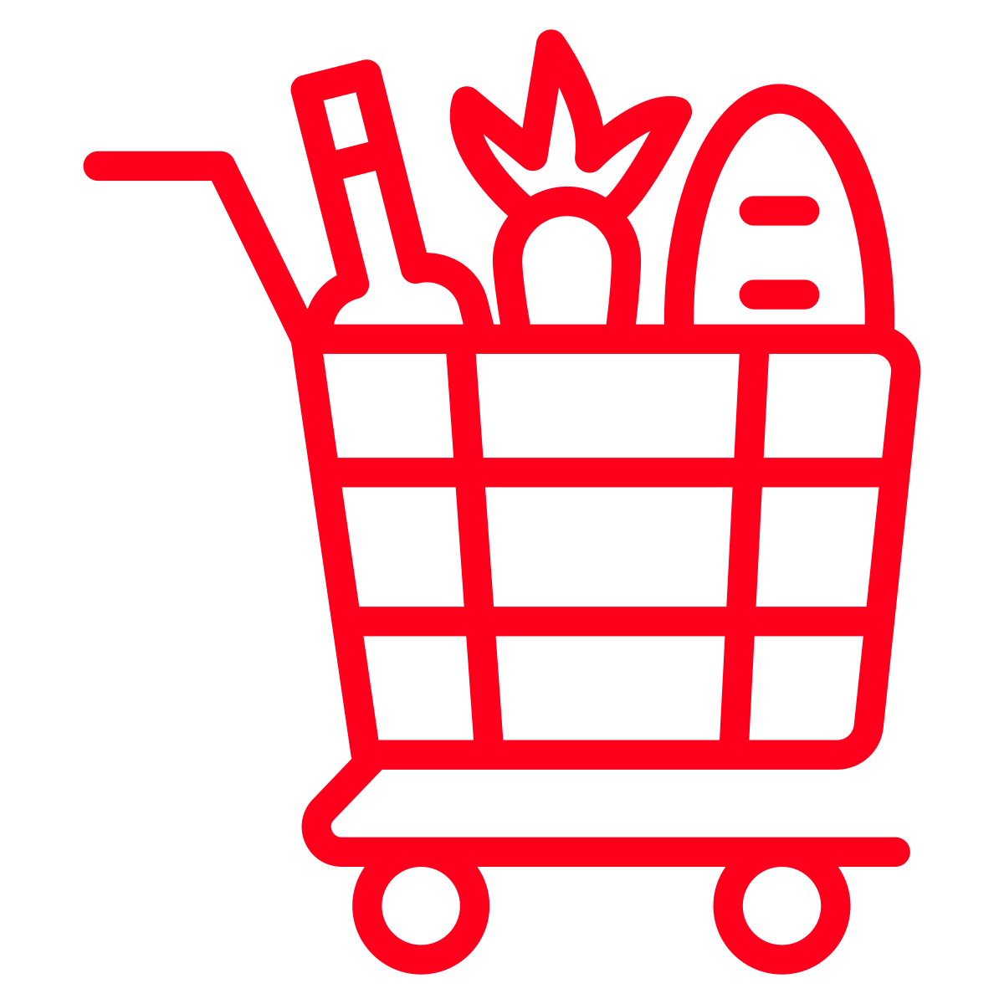



Top reasons did not convert (in no particular order)
Does not apply to NV | “Seems like it’s limited to restaurants and fast food only, It didn’t allow me to add Target. Since Target was unsuccessful I forgot about it” “I didn’t really pay attention to that because it didn’t apply to my orders [at grocery stores]”
Rx does not apply | “I just started new account for work, and I noticed that you can pick 3 restaurants and there were be some savings associated. I was using it for work, I was doing a specific group order for a predetermined place so I didn’t think it applied and I haven’t really thought about it since”
Incorrect understanding | “It’s a rating system and once you rate the restaurant you get $0 delivery fee. I didn’t write a review but I would do the stars. When you click on the restaurant it has a section that says what are people saying and you can click to see what people are saying” “I assume there is a promotion code that will show up at checkout and that I can use it up to three times in a month”
Did not like Rx selected | “I remember that McDonalds was filled in for me and I don’t know why…I would never order McDonalds on DoorDash so it wasn’t helpful”

Slide 7

Top areas of confusion (in no particular order)
How do I star something?
What restaurants or stores are included? How do I find included restaurants?
Is there a limit on the number of orders?
Is there a promo code?
How permanent are the restaurants? Do I have to keep my preselected restaurant?
Confusion appears to be mostly driven by how Cx typically experience discounts:
A selection of restaurants are shown within the carousel
There is a promo code that shows up on the Rx page or checkout page
There is a limited amount of times that they can use an offer
Questions for further discussion:
Should we communicate Star and Save outside of a carousel?
What can we do to better explain how to star?

Slide 8

Saving stores & testing limits
Most Cx assumed that the three restaurants we’re all you could use
  Some thought there was a limit on how many times you could order from that Rx in a month
  Because of this there was some hesitancy to load Rx upfront; Cx who used it prefer to select
5 out of 6 Cx did not realize that they could change their preselected store, to them it felt like they could select up to 2 additional stores
One Cx learned that you could swap out your 3 and has used that functionality. However, they see how that might not be reasonable and think limitations are fair.
  All Cx, including this one felt that it was fair to have a limit on how frequently you could swap your restaurants (1-2 times a month was most frequently mentioned time frame)
“I would think that it’s limited to these three restaurants. I think it would make me use it less if I can’t choose the three restaurants I like.”“I would expect to swap out every 2-3 weeks or every month.”
“It feels like thank you for being a loyal DoorDash user, here’s a little bit of cost saving… I guess it doesn’t make sense for me to be able to switch out breakfast lunch and dinner, that's not practical”

Slide 9
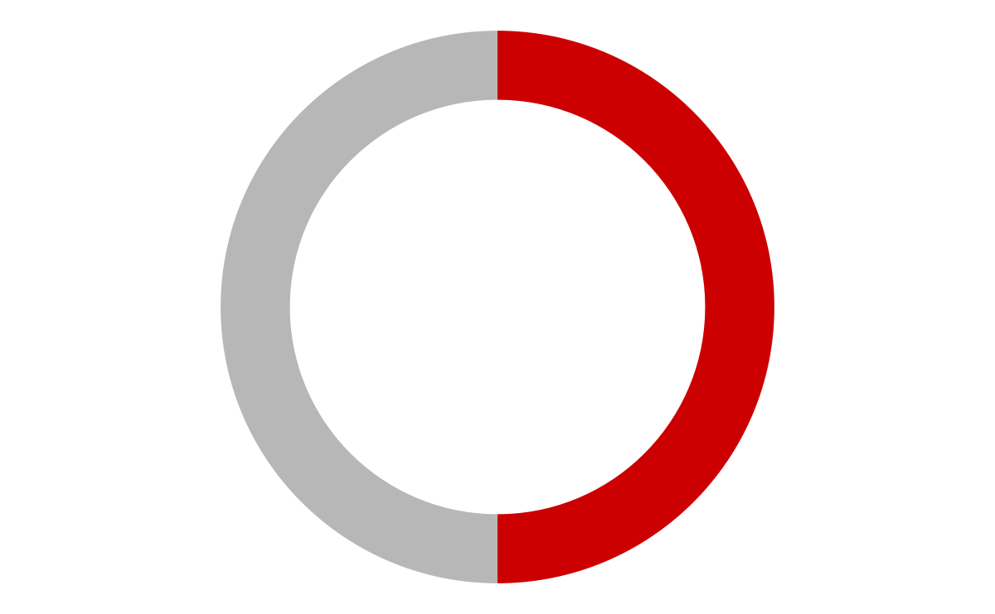
Clarification on limits may help increase future ordering
Cx that felt it would not increase their order frequency felt so because…
Already use DoorDash at a very high frequency
Deliberate in their focus on cooking at home more often
Frequency would shift based on restaurants available (misunderstanding of program)
Half of Cx interviewed indicated that they felt Star and Save would increase their order frequency
Would want to hit max orders possible to get a discount
Removed the friction point of it being cheaper to just go to the store
Questions for further discussion:
Should we put limits in place to act as goals?
Can we support Cx who are ordering less for personal/health reasons?

Slide 10
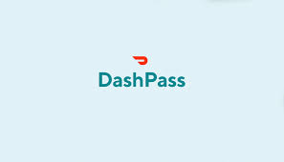
What about DashPass?
2 Cx talked about DashPass unprompted, for these Cx we probed on DashPass vs. Star and Save:
One Cx did not expect to sign up for DashPass because they did not want to increase their order frequency further (they are already a high frequency orderer), they view Star and Save as separate thank you for being a loyal DoorDash Cx
One Cx is brand new to DoorDash and does not know what to make of either. He would need to calculate his potential savings, and if he saves more with DashPass, he would sign up
Questions for further discussion:
Star and Save is likely to have similar challenges with DashPass adoption to Nearby, how can we get in front of those challenges?

Slide 11
What can we do?
(Let’s brainstorm for a few mins!)

Slide 12
What if we….
Create an onboarding flow that requires Cx to confirm or replace their first select Rx
Find a “certainty” threshold for Rx prediction, leave the spot blank if we do not have enough info on a Cx
Experiment with limitations to see how it impacts behavior
  # of orders per month
  Time constraints on swapping your 3
Add text that says “add any store for unlimited orders” in the current blank slots on the homepage
Include more detail on “How to Star” a restaurant including the ability to click to an image that highlights the process
Included more locations where you can click to learn more (maybe with a landing page that feels branded)
Shut off all other $0 delivery offers in test markets
Promote Star and Save in a banner rather than a carousel format
Excluded new Cx from Star and Save for their first 30 days
  Additional analytics needed to understand the right timing

Slide 13



Next steps
DEBRIEF: KP to schedule debrief with Star and Save core team
  Ensure consistent understanding of insights
  Review ideas from research and brainstorm
KEEP DIGGING: KP to conduct next round of Star and Save interviews on Wed 4/19
  Audience and goals to be confirmed with core team
QUANTIFY: KP to create research brief for Star and Save convert vs. non-convert survey
  Timing to be confirmed with core team and aligned with comms to avoid extensive list suppression

Slide 14
Status of ongoing & upcoming research

Slide 15
Ongoing/upcoming research
DashPass Via Nearby
Batching/ETA Padding
Comparing Across Apps
8 Interviews completed this week
Memo to be shared by EOD Monday 4/17
Delayed to better align with experiment scale
Survey going out mid-week next week with interviews the following week
Insights to be shared at next bi-weekly call on 4/28
Review the brief/survey here!
Fielding next week
PAD Research Planning now at a monthly cadence, have questions for May? Lets talk!

Slide 16
Thank you!

